Slide 1


MARK GEN
First Review
(01.02.2017)
SUPERVISED BY
Mr. Prakash P
COMPLETED BY
Arun M (1313007)
Prabakaran P (1313081)
PraveenKumar M (1313084)
Vigneshwaran N (1313124)

Slide 2
ABSTRACT
Mark Generation is a system to speed up the process of generating internal marks of student and delivering the reports through electronic message. It allows faculties to generate reports in a predefined letter format with appropriate address and marks details for each student. Faculties can also send instant messages to students / parents through SMS. Mark Generation project digitalizes the mark generation process used currently.

Slide 3
PROPOSED SYSTEM
Proposed mark generation system is a web based application which can be accessed by faculties anywhere in the college network.
All details regarding students marks are updated to the central database.
Only authorized persons can update database.
Advisors can send reports to students / parents through SMS.
Advisors can also generate letters in a defined format automatically.(No need of mail-merge)
Faculties can also share necessary information's to students through short code messages.
Auto generation of internal marks based on regulation and formula.

Slide 4
SURVEY REPORT
All details are maintained in separate spreadsheets/files for each class, year, department.
There is no central repository / database to share mark details. COE provides only hard copies to share details to advisors.
High risk of data mismatch.
Generating reports in a defined format is a complex task as it needs to be generated for each student in the class.
There is no proof of delivery since reports are delivered as letters.
Result of the survey claims that a digitalized system is required by more than 80% of the employees as the existing system is complicated.

Slide 5
ADVANTAGE OF PROPOSED SYSTEM
A central database is maintained.
No duplicate data.
No data mismatch as authorized persons only can update database.
Lesser the amount of man power than existing system.
Low cost because reports are delivered through messages.
Any information can be passed to students through messages at any time.

Slide 6
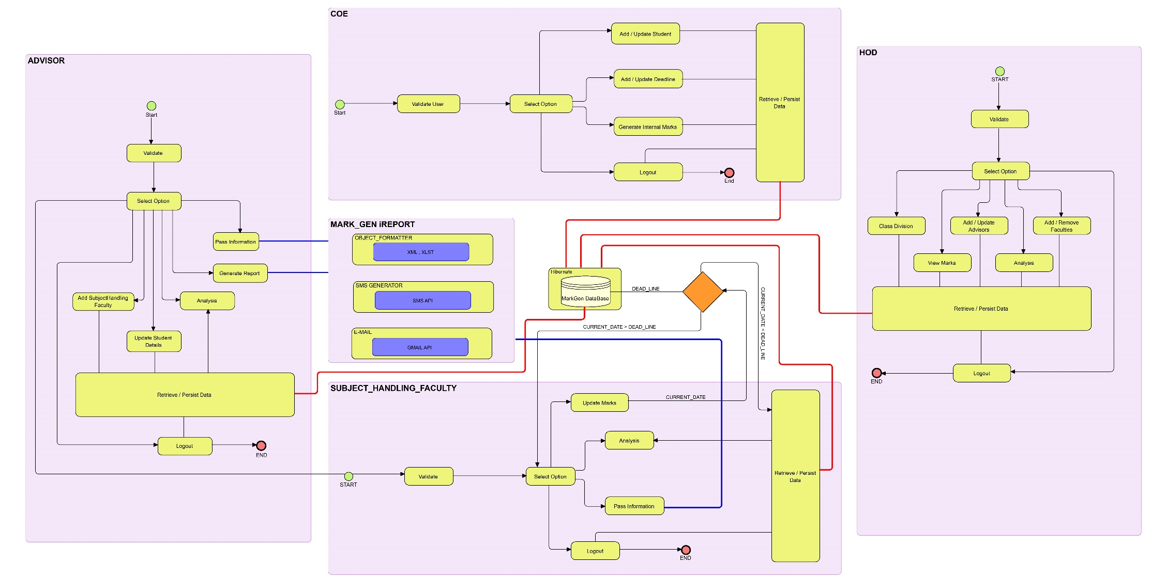
OVERALL SYSTEM ARCHITECTUERE

Slide 7
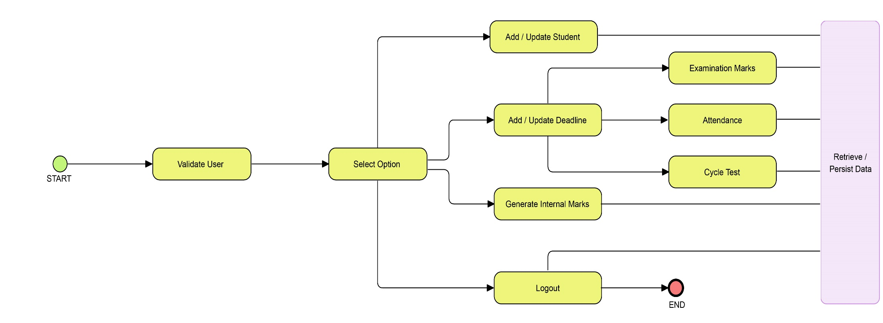
MODULES USED
COE

Slide 8
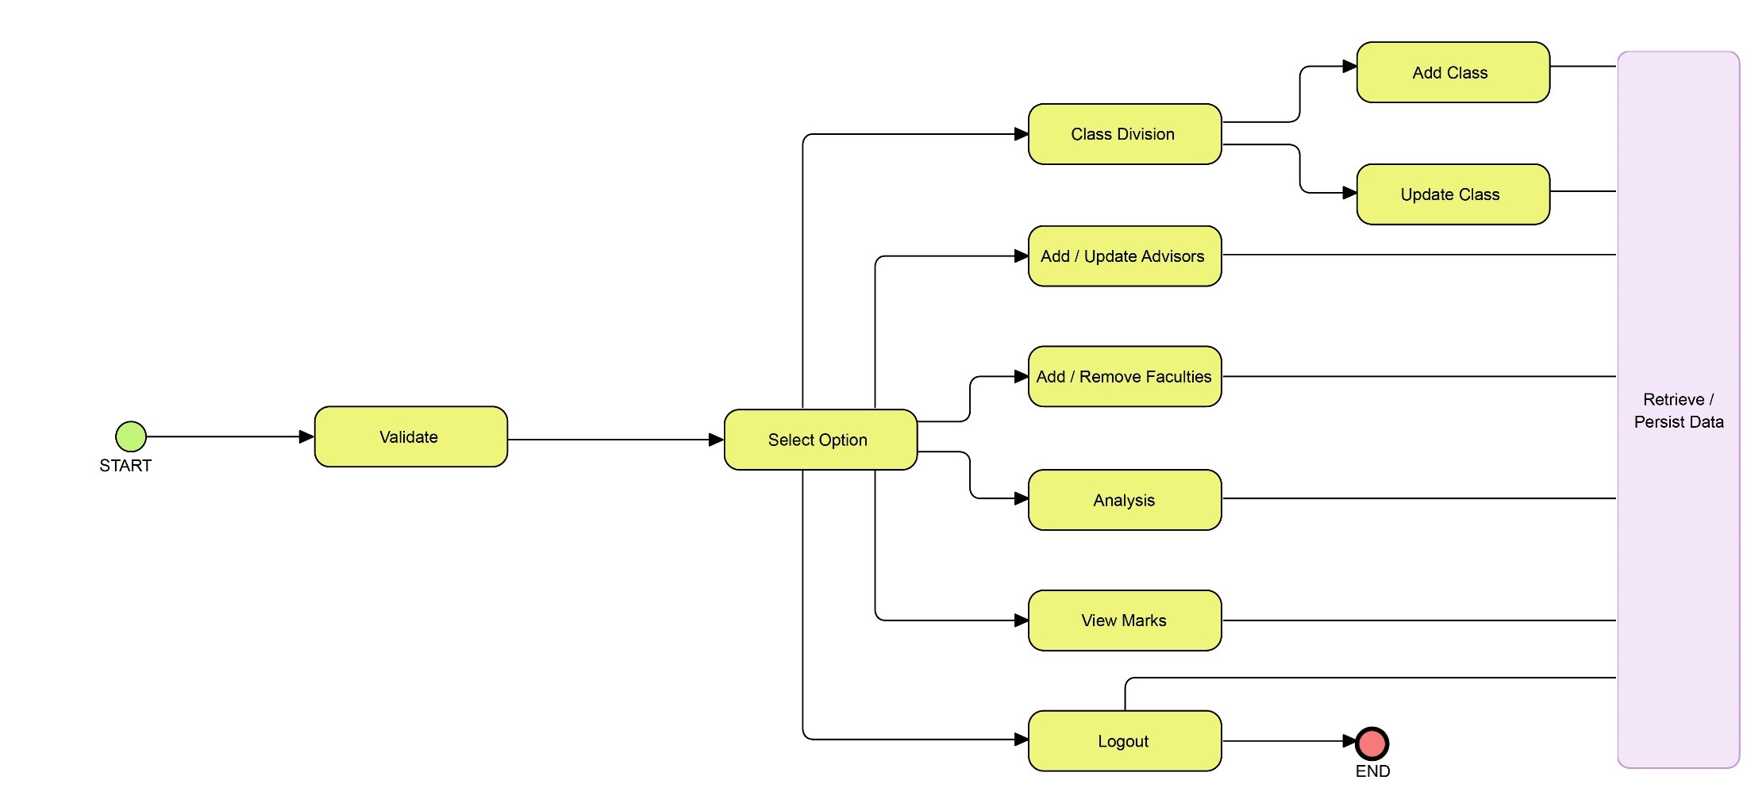
MODULES USED
HOD

Slide 9
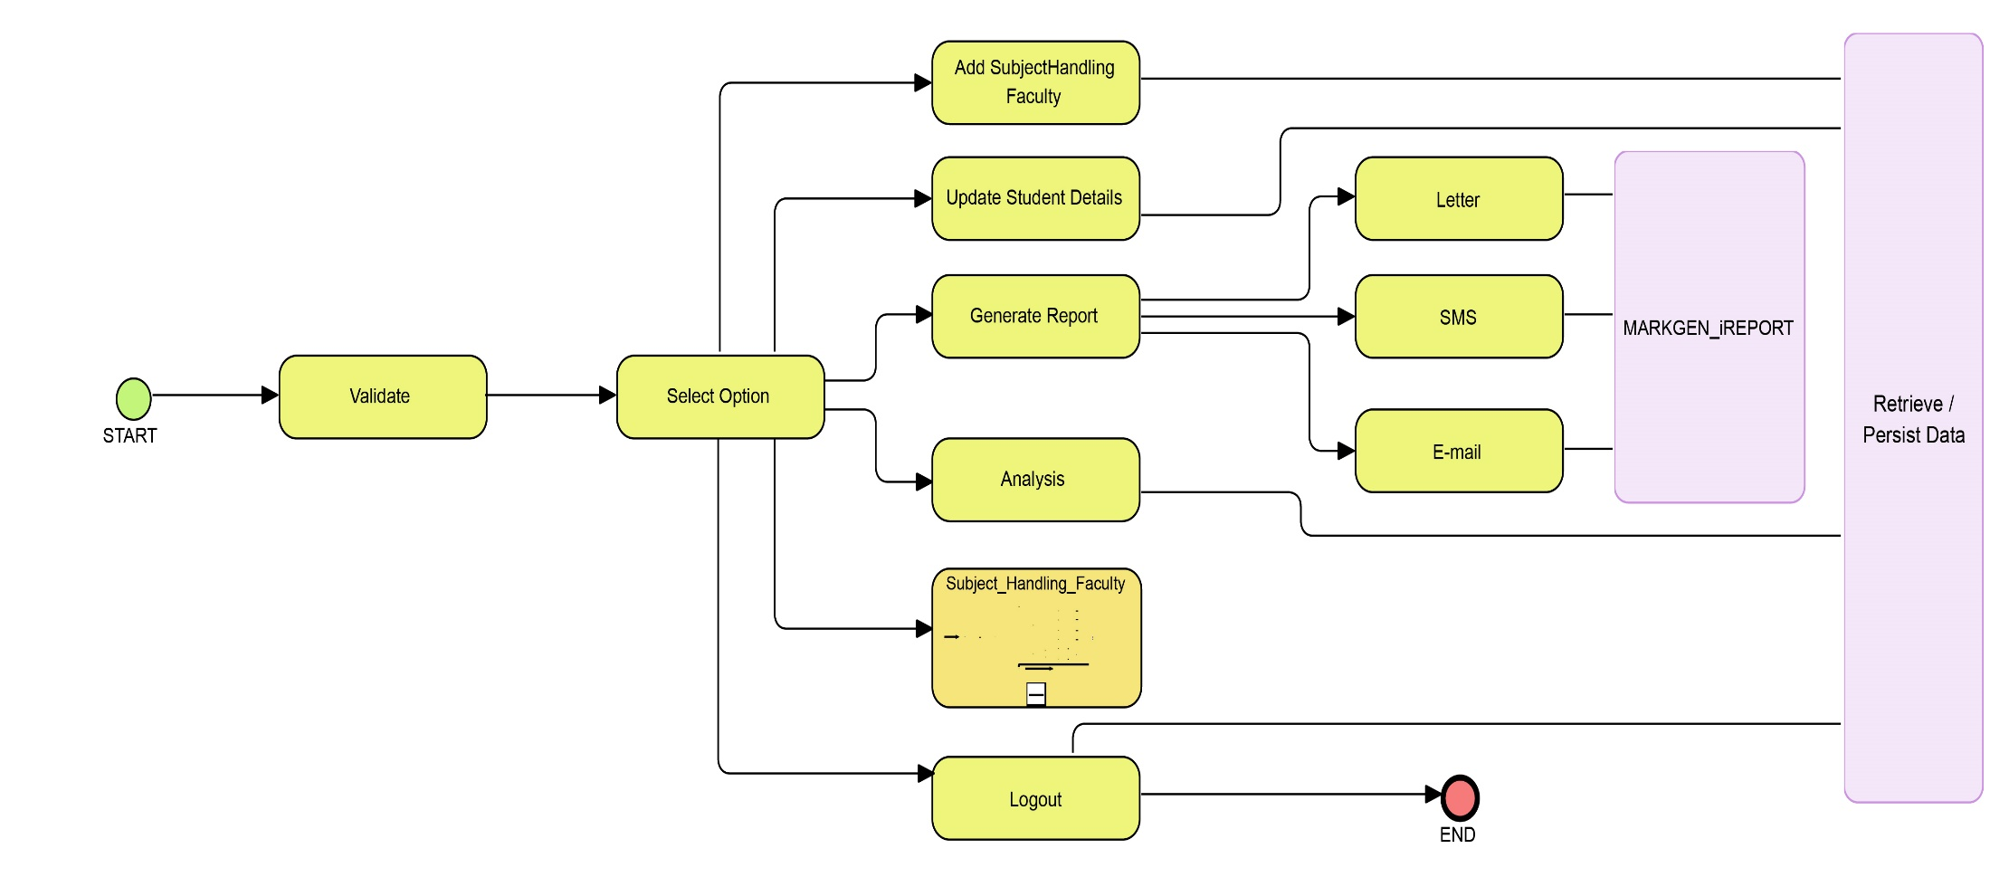
MODULES USED
ADVISORS

Slide 10
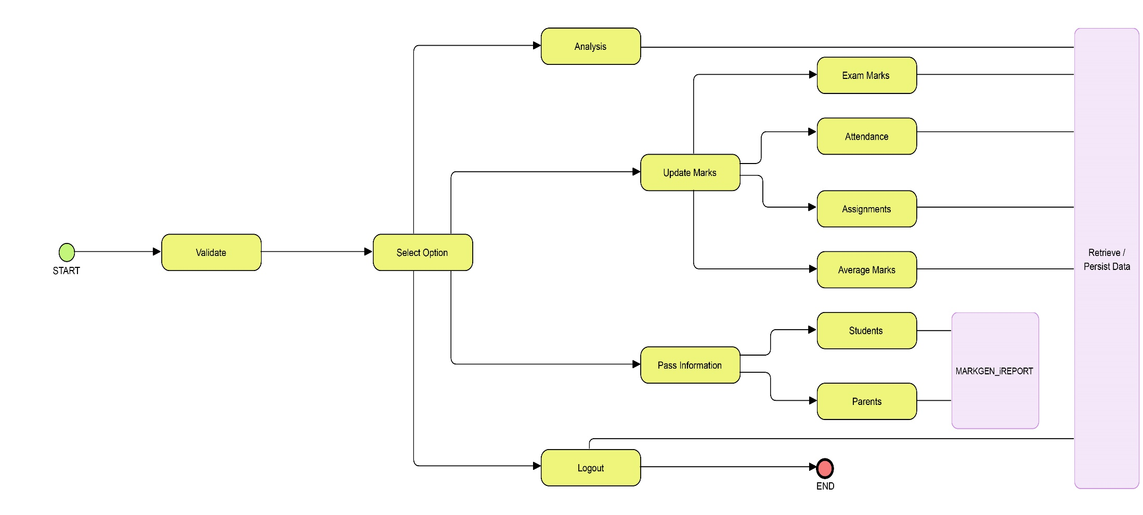
MODULES USED
SUBJECT_HANDLING_FACULTY

Slide 11
COE MODULE - EXPLANATION
COE adds list of students and their departments information into the MarkGen system.
For each examinations COE adds deadline, before which the marks are to be updated by staff (SUBJECT_HANDLING_FACULTY).
After all necessary details ( EXAMINATION_MARKS ,ASSIGNMENTS , ATTENDANCE ) are gathered from staff, COE can generate internal marks.
Deadline can be extended / modified for students whose tests are rescheduled.

Slide 12
HOD MODULE - EXPLANATION
HOD can group students into classes and update it into MarkGen database.
HOD can add / remove faculties into / from MarkGen database.
HOD can allocate advisors for all available classes.
HOD can view students marks at any time.
HOD can analyze students marks in forms of graph / chart.

Slide 13
ADVISOR MODULE - EXPLANATION
Advisors can add subject handling faculties for their class.
Only added faculties can update marks for their subjects.
Advisors can update students personal details.
If the advisor is also a subject handling faculty , he / she also can update marks for their handling class.
Advisors can generate report in the preferred way.
Advisors can also analyze marks of students.

Slide 14
SUBJECT_HANDLING_FACULTY MODULE
Subject handling faculties can update marks for their handling class.
Subject handling faculties can analyse marks for their handled subjects to view overall progress.
Subject handling faculties can pass information if any to students in the given way.

Slide 15
REFFERENCES
https://en.wikipedia.org/wiki/Requirements_analysis
https://www.tutorialspoint.com/uml/uml_standard_diagrams.htm
Book: Object Oriented Analysis and Design by Booch Jackson Rumbaugh.

